Slide 1
Valuation in Private Equity Settings
Narayanan Jayaraman
406 Scheller College of Business
Georgia Institute of Technology
Atlanta, GA 30332
Notes:
_________________________________________________________________
_________________________________________________________________
_________________________________________________________________
_________________________________________________________________
_________________________________________________________________
_________________________________________________________________
_________________________________________________________________
_________________________________________________________________

Slide 2
Valuation
“Technology is just something we don’t understand, so we don’t invest in it.”
Warren Buffett
“If I taught a class, on my final exam I would take an Internet company and ask [my students], ‘ How much is this company worth?’ Anyone who would answer, I would flunk.”
Notes:
_________________________________________________________________
_________________________________________________________________
_________________________________________________________________
_________________________________________________________________
_________________________________________________________________
_________________________________________________________________
_________________________________________________________________
_________________________________________________________________

Slide 3
Introduction
Underlying discipline for a wide variety of financial activities
Structuring mergers and leveraged buyouts
Security analysts and undervalued stocks
Pricing Initial Public Offerings
Corporate strategy and value based management
Venture Capitalists’ evaluation of new investment opportunities
Notes:
________________________________________________________________
_________________________________________________________________
_________________________________________________________________
_________________________________________________________________
_________________________________________________________________
_________________________________________________________________
_________________________________________________________________
_________________________________________________________________

Slide 4
Considerations in Valuation
Qualitative Considerations
Quantitative Considerations
Notes:
________________________________________________________________
_________________________________________________________________
_________________________________________________________________
_________________________________________________________________
_________________________________________________________________
_________________________________________________________________
_________________________________________________________________
_________________________________________________________________

Slide 5
Qualitative Considerations
Industry Dynamics
Product / Service related
Organizational factors
Manufacturing or process
Legal or other
Notes:
________________________________________________________________
_________________________________________________________________
_________________________________________________________________
_________________________________________________________________
_________________________________________________________________
_________________________________________________________________
_________________________________________________________________
_________________________________________________________________

Slide 6
Industry Dynamics
Industry Growth Phase
Company Posture
Embryonic
Developmental
Expansion
Consolidation
Mature
Unique , high value technology
Strong niche or other position
Good strategy and execution
Consolidator or acquisition prospect
Low cost producer
High margin products, or both
Notes:
________________________________________________________________
_________________________________________________________________
_________________________________________________________________
_________________________________________________________________
_________________________________________________________________
_________________________________________________________________
_________________________________________________________________
_________________________________________________________________

Slide 7
Industry Dynamics (cont’d.)
Other Factors
Market size - present and forecast
Regulatory climate
Geographical constraints
Import / Export dynamics
Cost structures
Notes:
________________________________________________________________
_________________________________________________________________
_________________________________________________________________
_________________________________________________________________
_________________________________________________________________
_________________________________________________________________
_________________________________________________________________
_________________________________________________________________

Slide 8
Product or Service - Related Factors
Strength of proprietary position
  Technology company
    Patent strength
    Alternative approaches
    Quality of platform(s)
  Manufacturer
    Uniqueness of process
    Product change skills
  Marketer / Retailer
    Distribution model
    Data system
Notes:
________________________________________________________________
_________________________________________________________________
_________________________________________________________________
_________________________________________________________________
_________________________________________________________________
_________________________________________________________________
_________________________________________________________________
_________________________________________________________________

Slide 9
Product or Service - Related Factors (cont’d.)
Customer characteristics
  Size, diversity of user base
  Satisfaction measures
  Interaction with provider
  Warranty issues
Notes:
________________________________________________________________
_________________________________________________________________
_________________________________________________________________
_________________________________________________________________
_________________________________________________________________
_________________________________________________________________
_________________________________________________________________
_________________________________________________________________

Slide 10
Product or Service - Related Factors (cont’d.)
Distribution methods and skills
  Sales channels - direct, through reps, etc.
  Productivity
  Potential for other channels
  Potential for international sales
Service and Support
  Adequacy assessment
  Profitability measures
  Spare parts revenues / margins
Notes:
________________________________________________________________
_________________________________________________________________
_________________________________________________________________
_________________________________________________________________
_________________________________________________________________
_________________________________________________________________
_________________________________________________________________
_________________________________________________________________

Slide 11
Organizational Factors
Effectiveness of present CEO
  As visionary
  As leader
  As operator / administrator
Strength of middle management
  Performance to success measures
  As team builders
  As team members
  As support upstream
Staff productivity factors
  Financial measures
  Non-Financial measures
Notes:
________________________________________________________________
_________________________________________________________________
_________________________________________________________________
_________________________________________________________________
_________________________________________________________________
_________________________________________________________________
_________________________________________________________________
_________________________________________________________________

Slide 12
Manufacturing or Process
Operating Leverage: How to benefit?
Flexibility to modify product / process
Outsourcing opportunities
Logistics improvements
Notes:
________________________________________________________________
_________________________________________________________________
_________________________________________________________________
_________________________________________________________________
_________________________________________________________________
_________________________________________________________________
_________________________________________________________________
_________________________________________________________________

Slide 13
Legal and Other
Customer disputes
Site environmental analysis
Employee issues
Other hidden liabilities
Notes:
________________________________________________________________
_________________________________________________________________
_________________________________________________________________
_________________________________________________________________
_________________________________________________________________
_________________________________________________________________
_________________________________________________________________
_________________________________________________________________

Slide 14
Financial Considerations
Profitability analysis
  Sales growth prospects
  Manufacturing cost structure
  Gross Margin - up or down?
Asset management review
  Working capital - DSO levels
  Inventory turns - targets
  Capital expenditure levels
Other: Trust no ledger entry
Notes:
________________________________________________________________
_________________________________________________________________
_________________________________________________________________
_________________________________________________________________
_________________________________________________________________
_________________________________________________________________
_________________________________________________________________
_________________________________________________________________

Slide 15
Quantitative Valuation
Difficult and Subjective Process
Negative Cash Flows
Highly Uncertain Future Rewards
Tool Kit for Valuation
Notes:
_________________________________________________________________
_________________________________________________________________
_________________________________________________________________
_________________________________________________________________
_________________________________________________________________
_________________________________________________________________
_________________________________________________________________
_________________________________________________________________

Slide 16
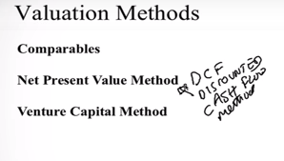
Valuation Methods
Comparables
Net Present Value Method
Venture Capital Method
Notes:
_________________________________________________________________
_________________________________________________________________
_________________________________________________________________
_________________________________________________________________
_________________________________________________________________
_________________________________________________________________
_________________________________________________________________
_________________________________________________________________

Slide 17
Comparables Method
Similar Value Characteristics
Risk
Growth Rate
Capital Structure
Size and Timing of Cash Flows
Characteristics of the underlying firm - HMO, Cable Cos
Notes:
_________________________________________________________________
_________________________________________________________________
_________________________________________________________________
_________________________________________________________________
_________________________________________________________________
_________________________________________________________________
_________________________________________________________________
_________________________________________________________________

Slide 18
Comparables
Weaknesses
Valuation of Private Firms
Financial Information often unavailable.
Valuations may be misguided.
Notes:
_________________________________________________________________
_________________________________________________________________
_________________________________________________________________
_________________________________________________________________
_________________________________________________________________
_________________________________________________________________
_________________________________________________________________
_________________________________________________________________

Slide 19
Comparables
Public Firms
Price/Earnings Ratio
Price/EBIT as an alternative
Market Value of Equity/Sales
Market Value of Equity/Book Value of Equity
Private Firms
Internet -- Number of Subscribers
Biotechnology -- Number of Patents
Industry Specific Multiples More Explanatory Power
Notes:
_________________________________________________________________
_________________________________________________________________
_________________________________________________________________
_________________________________________________________________
_________________________________________________________________
_________________________________________________________________
_________________________________________________________________
_________________________________________________________________

Slide 20
Comparables
Use of Public Market Comparables to Value Private Companies
Use Discount for Liquidity - 20 to 25 %
Notes:
http://www.vernimmen.com/Practice/Glossary/definition/Liquidity%20discount.html
https://www.smytheadvisory.com/blog/the-liquidity-discount/

Slide 21
Comparables Example
 | Private Health | Happy Healthcare | Community Health
 |  | ($MM)
Balance Sheet
Assets | 160 | 300 | 380
Long-Term Debt | 5 | 100 | 0
Net Worth | 80 | 120 | 175
Income Statement
Revenues | 350 | 420 | 850
EBITDA | 45 | 55 | 130
Net Income | 30 | 20.0 | 75.0
Market Data
Earnings per Share ($/share) | 3.00 | 0.67 | 2.14
Price-Earnings Ratio (times) | n/a | 21.0 | 14.5
Shares Outstanding (m) | 10 | 30 | 35
Number of Members | 500,000 | 600,000 | 1,100,000

Slide 22
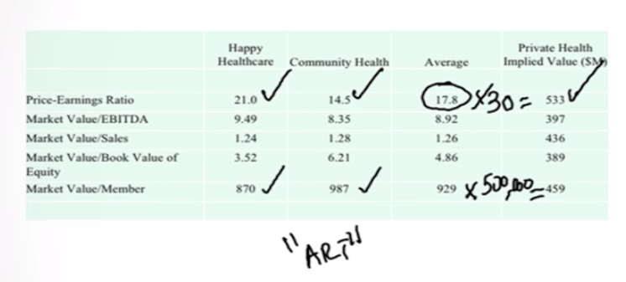
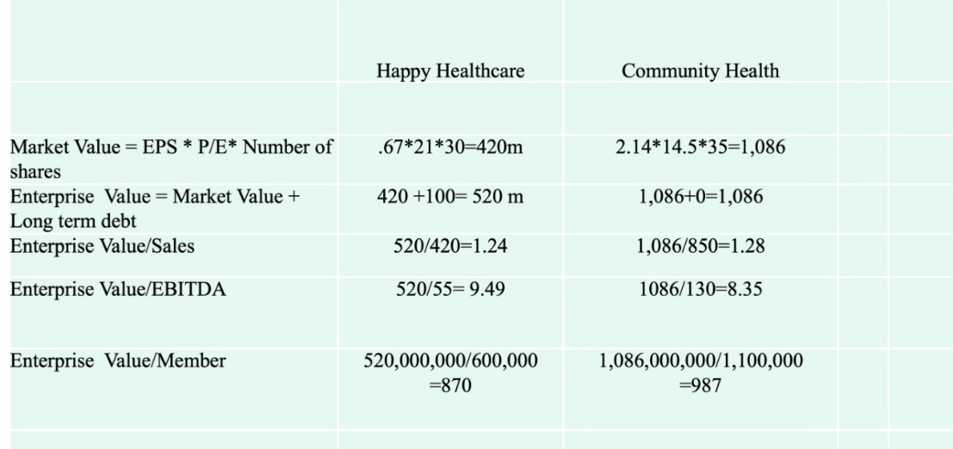
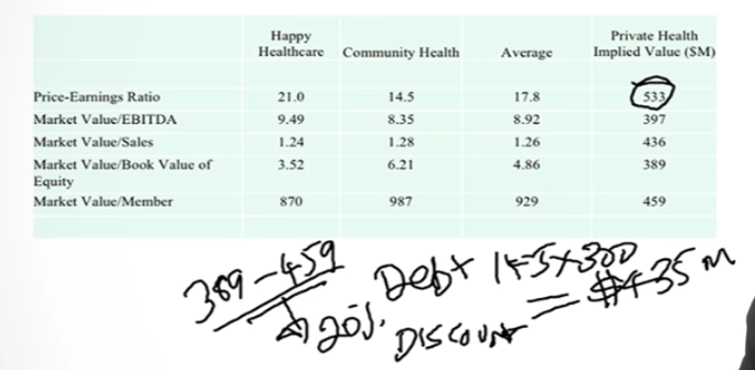
Comparables Example
 | Happy Healthcare | Community Health | Average | Private Health Implied Value ($M)
Price-Earnings Ratio | 21.0 | 14.5 | 17.8 | 533
Market Value/EBITDA | 9.49 | 8.35 | 8.92 | 397
Market Value/Sales | 1.24 | 1.28 | 1.26 | 436
Market Value/Book Value of Equity | 3.52 | 6.21 | 4.86 | 389
Market Value/Member | 870 | 987 | 929 | 459
Notes:
Community health has zero debt.
Very close to private health. We can take 14.5 X 30 only.
It is an art.

Slide 23
Net Present Value Method
CF_{t} = EBIT_{t} * (1-T) +Depr._{t} - CAPEX_{t} - ΔNWC_{t}
CF = Cash Flow
EBIT = Earnings Before Interest and Taxes
T = Corporate Tax Rate
DEPR = Depreciation
CAPEX= Capital Expenditures
ΔNWC = Increase in Net Working Capital
Notes:
https://corporatefinanceinstitute.com/resources/knowledge/valuation/what-is-free-cash-flow-fcf/
What is Free Cash Flow

Slide 24
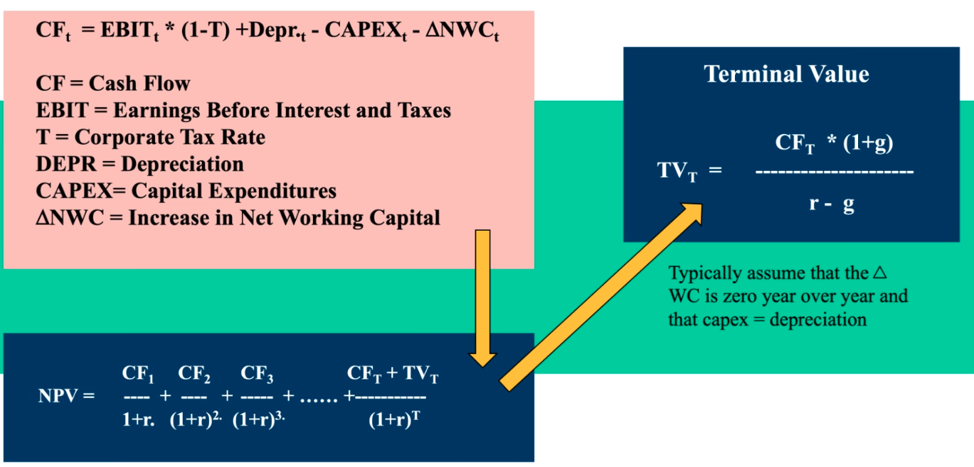
Net Present Value
CF_{T} * (1+g)
TV_{T} = ---------------------
r - g
CF₁ CF₂ CF₃ CF_{T} + TV_{T}
NPV = ---- + ---- + ----- + +-----------
1+r (1+r)² (1+r)³ (1+r)^{T}
r = (D/V) * Cost of Debt* (1-T) + (E/V) * Cost of Equity
Cost of Equity = Risk Free Rate
+ Beta (Market Risk Premium)
Notes:
_________________________________________________________________
_________________________________________________________________
_________________________________________________________________
_________________________________________________________________
_________________________________________________________________
_________________________________________________________________
_________________________________________________________________
_________________________________________________________________

Slide 25
Net Present Value
Risk-Free Rate = 10 Year T-bond Rate
Market Risk Premium = 6 %
Notes:
_________________________________________________________________
_________________________________________________________________
_________________________________________________________________
_________________________________________________________________
_________________________________________________________________
_________________________________________________________________
_________________________________________________________________
_________________________________________________________________

Slide 26
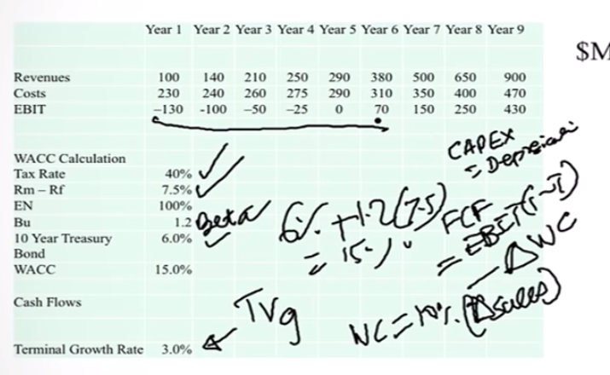
NPV Example
 | Year 1 | Year 2 | Year 3 | Year 4 | Year 5 | Year 6 | Year 7 | Year 8 | Year 9
Revenues | 100 | 140 | 210 | 250 | 290 | 380 | 500 | 650 | 900
Costs | 230 | 240 | 260 | 275 | 290 | 310 | 350 | 400 | 470
EBIT | –130 | -100 | –50 | –25 | 0 | 70 | 150 | 250 | 430
WACC Calculation
Tax Rate | 40%
Rm – Rf | 7.5%
EN | 100%
Bu | 1.2
10 Year Treasury Bond | 6.0%
WACC | 15.0%
Cash Flows
Terminal Growth Rate | 3.0%
$MM

Slide 27
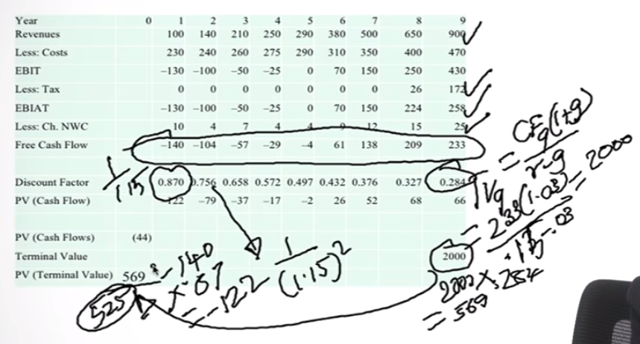
NPV Example
Year | 0 | 1 | 2 | 3 | 4 | 5 | 6 | 7 | 8 | 9
Revenues |  | 100 | 140 | 210 | 250 | 290 | 380 | 500 | 650 | 900
Less: Costs |  | 230 | 240 | 260 | 275 | 290 | 310 | 350 | 400 | 470
EBIT |  | –130 | –100 | –50 | –25 | 0 | 70 | 150 | 250 | 430
Less: Tax |  | 0 | 0 | 0 | 0 | 0 | 0 | 0 | 26 | 172
EBIAT |  | –130 | –100 | –50 | –25 | 0 | 70 | 150 | 224 | 258
Less: Ch. NWC |  | 10 | 4 | 7 | 4 | 4 | 9 | 12 | 15 | 25
Free Cash Flow |  | –140 | –104 | –57 | –29 | –4 | 61 | 138 | 209 | 233
Discount Factor |  | 0.870 | 0.756 | 0.658 | 0.572 | 0.497 | 0.432 | 0.376 | 0.327 | 0.284
PV (Cash Flow) |  | –122 | –79 | –37 | –17 | –2 | 26 | 52 | 68 | 66
PV (Cash Flows) | (44)
Terminal Value |  |  |  |  |  |  |  |  |  | 2000
PV (Terminal Value) | 569

Slide 28
NPV Example
Net Present Value and Sensitivity Analysis
PV (Cash Flows) | (44)
PV (Terminal Value) | 569
Net Present Value | 525
Tax Calculation
EBIT |  | –130 | –100 | –50 | –25 | 0 | 70 | 150 | 250 | 430
NOLs Used |  | 0 | 0 | 0 | 0 | 0 | 70 | 150 | 185 | 0
NOLs Added |  | 130 | 100 | 50 | 25 | 0 | 0 | 0 | 0 | 0
Tax |  | 0 | 0 | 0 | 0 | 0 | 0 | 0 | 26 | 172
Beginning NOLs |  | 100 | 230 | 330 | 380 | 405 | 405 | 335 | 185 | 0
Ending NOLs |  | 230 | 330 | 380 | 405 | 405 | 335 | 185 | 0 | 0
Net Working Capital (10% sales)
Beg NWC |  |  | 10 | 14 | 21 | 25 | 29 | 38 | 50 | 65
End NWC |  | 10 | 14 | 21 | 25 | 29 | 38 | 50 | 65 | 90
Ch. NWC |  | 10 | 4 | 7 | 4 | 4 | 9 | 12 | 15 | 25

Slide 29
Sensitivity Analysis
 |  |  | WACC
 |  |  | 13% | 15% | 17%
Terminal |  | 2% | 699 | 476 | 323
Growth |  | 3% | 778 | 525 | 355
Rate |  | 4% | 876 | 583 | 391

Slide 30
Simulation
 | Assumptions
Assumption: WACC
Normal distribution with parameters:
Mean | 15.0%
Standard Dev. | 1.5%
Assumption: Terminal Growth Rate
Normal distribution with parameters:
Mean | 3.0%
Standard Dev. | 0.3%
Assumption: Free Cash Flow (Year 1)
Normal distribution with parameters:
Mean | -140
Standard Dev. | 14

Slide 31
Simulation Results
Statistics: |  | Value
Trials |  | 500
Mean |  | 562
Median |  | 535
Mode |  | ---
Standard Deviation |  | 194
Variance |  | 37485
Skewness |  | 0.89
Kurtosis |  | 4.05
Coeff. of Variability |  | 0.34
Range Minimum |  | 162
Range Maximum |  | 1296
Range Width |  | 1134
Mean Std. Error |  | 8.66

Slide 32
Net Present Value
Weaknesses
Point Estimate
Beta Estimation from Comparables
Terminal Values Play a Crucial Role
Changing Capital Structures or Effective Tax Rates
NPV method assumes the capital structure and effective
tax rates are both incorporated in the discount rate
(WACC) and assumed to be constant
Simulation
Notes:
_________________________________________________________________
_________________________________________________________________
_________________________________________________________________
_________________________________________________________________
_________________________________________________________________
_________________________________________________________________
_________________________________________________________________
_________________________________________________________________

Slide 33
Venture Capital Method
Commonly used. Uses a multiple at a time in future when the firm is expected to have achieved positive cash flows and/or earnings.
This “Terminal Value” is discounted back using discount rates of 40% to 75%.
If the company’s discounted terminal value is $10 million, and the VC is providing $ 5 million, she will want 50% of the company.
This assumes no dilution.
A four step procedure is used.
Notes:
_________________________________________________________________
_________________________________________________________________
_________________________________________________________________
_________________________________________________________________
_________________________________________________________________
_________________________________________________________________
_________________________________________________________________
_________________________________________________________________

Slide 34
Venture Capital
1) Terminal Value is usually calculated using a multiple.
2) The discounted terminal value (DTV) obtained by :
Terminal Value
Discounted Terminal Value = ------------------
(1 + Target Rate) ^{years}
3) Investment
Required Final % Ownership = -------------------
DTV
Notes:
_________________________________________________________________
_________________________________________________________________
_________________________________________________________________
_________________________________________________________________
_________________________________________________________________
_________________________________________________________________
_________________________________________________________________
_________________________________________________________________

Slide 35
Venture Capital
4) Venture-backed companies commonly receive multiple
rounds of financing, followed by an IPO.
Retention Ratio quantifies the expected dilutive effect of
future rounds of financing on the VC’s ownership.
Consider a firm intends one more financing round, in which share representing additional 25% of the firm’s equity will be sold, and then sell additional 30% of the firm at the time of the IPO.
If the VC owns 10% today, after financings her stake will be 10/(1+.25)/(1+.3)=6.15%.
Retention Ratio = 6.15/10=61.5%
Notes:
_________________________________________________________________
_________________________________________________________________
_________________________________________________________________
_________________________________________________________________
_________________________________________________________________
_________________________________________________________________
_________________________________________________________________
_________________________________________________________________

Slide 36
Venture Capital
Required Final % Ownership
Required Current % Ownership = ----------------------------------------
Retention Ratio
Weakness
Large Discount Rates
Illiquidity
Strategic Advice, Network
Optimistic Entrepreneurial Forecasts
Financial Economists Disagreement
Notes:
_________________________________________________________________
_________________________________________________________________
_________________________________________________________________
_________________________________________________________________
_________________________________________________________________
_________________________________________________________________
_________________________________________________________________
_________________________________________________________________

Slide 37
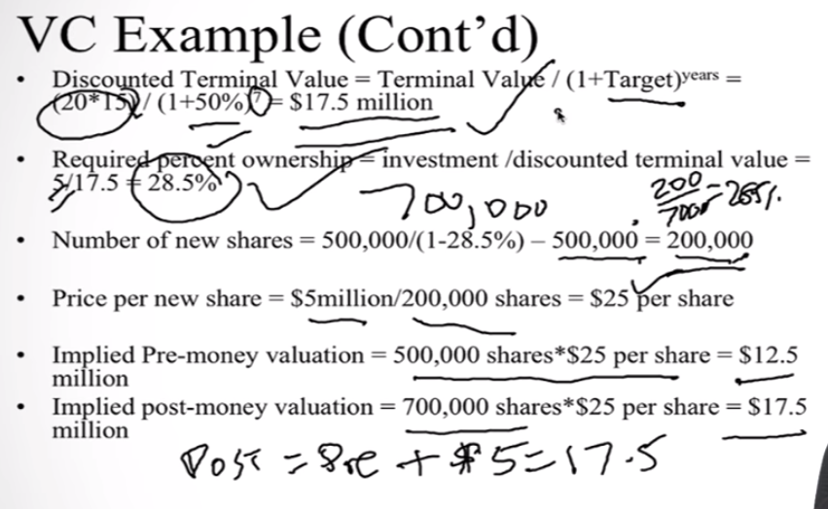
VC Valuation Example
James is a partner in a very successful Boston-based venture capital firm. He plans to invest $5 million in a start-up biotechnology venture and must decide what share of the company he should demand for his investment. Projections he developed with company management show net income in year seven of $20million. The few profitable biotechnology companies are trading at an average price-earnings ratio of 15. The company currently has 500,000 shares outstanding. James believes that a target rate of return of 50% is required for a venture of this risk. He performs the following calculations:

Slide 38
VC Example (Cont’d)
Discounted Terminal Value = Terminal Value / (1+Target)^{years} = (20*15) / (1+50%)⁷ = $17.5 million
Required percent ownership = investment /discounted terminal value = 5/17.5 = 28.5%
Number of new shares = 500,000/(1-28.5%) – 500,000 = 200,000
Price per new share = $5million/200,000 shares = $25 per share
Implied Pre-money valuation = 500,000 shares*$25 per share = $12.5 million
Implied post-money valuation = 700,000 shares*$25 per share = $17.5 million

Slide 39
VC Example (Cont’d)
James and his partners are of the opinion that three more senior staff will need to be hired. In James’s experience this number of top caliber recruits would require options amounting to 10% of the common stock outstanding. Additionally, he believes that, at the time the firm goes public, additional shares equivalent to 30% of the common stock will be sold to the public. He amends his calculations as follows:
Retention ratio = [1/(1+.1)]/(1+.3) = 70%
Required current percent ownership = required final percent ownership /retention ratio = 28.5%/70% = 40.7%
Number of new shares = 500,000/(1-40.7%)-500,000 = 343,373
Price per new share = $5million/343,373 shares = $14.56 per share
Notes:
The retention ratio is the proportion of earnings kept back in the business as retained earnings. The retention ratio refers to the percentage of net income that is retained to grow the business, rather than being paid out as dividends.

Slide 40
Strengths and Weaknesses of
Different Valuation Methods
Strength Weaknesses
___________________________________________________________
Comparable Quick to use Private companies
Simple to understand comparable difficult
Commonly used to find
Market based If public company
comparables use
liquidity discount
___________________________________________________________
Discounted Cash Theoretically Sound Cash flows difficult
Flow to estimate
WACC assumes constant
capital structure
Sensitive to terminal
growth assumptions
_____________________________________________________________________
Venture Capital Quick to use Relies on terminal value
Simple to understand from other methods
Commonly used Large discount rates

Slide 41
Suggested Additional Readings
How Venture Capitalists Evaluate Potential Venture Opportunities --- HBS Case 9-085-019
2. Venture Capital and Finance of Innovation by Andrew Metrick and Ayoko Yasuda, 2010, John Wiley & Sons.
Notes:
_________________________________________________________________
_________________________________________________________________
_________________________________________________________________
_________________________________________________________________
_________________________________________________________________
_________________________________________________________________
_________________________________________________________________
_________________________________________________________________

